Slide 1

Ever wondered ..
IF
YOUR
BRAND
SHINES

Slide 2
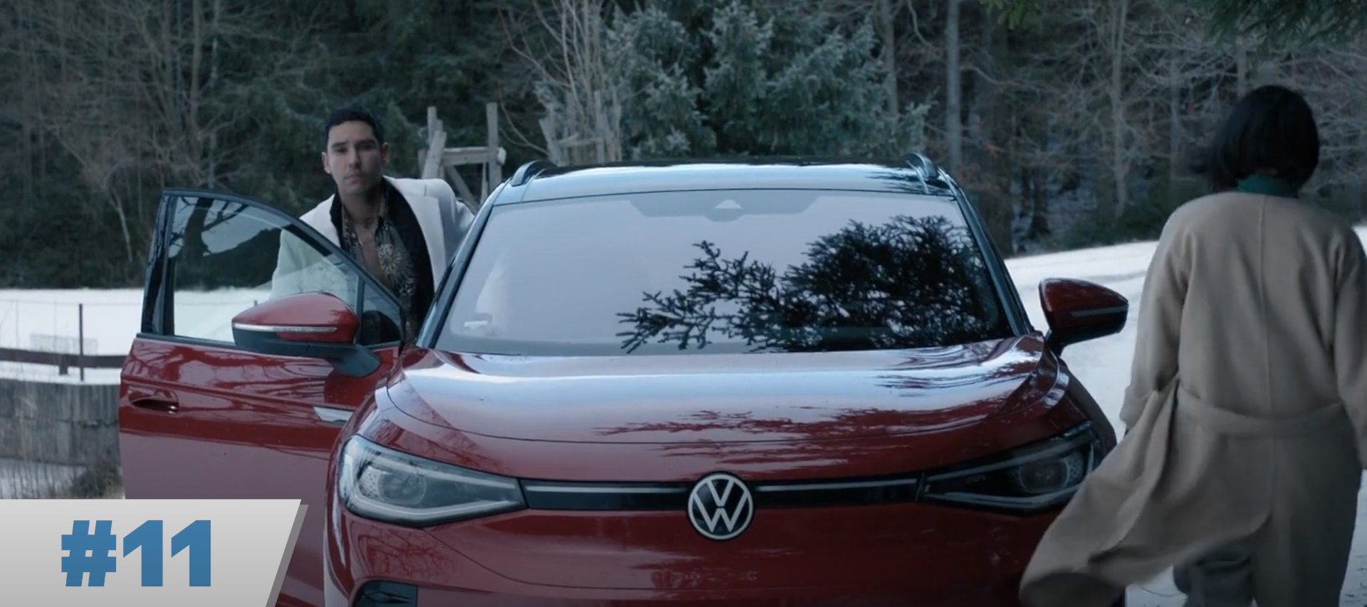
Extraction (Part II)

Slide 3
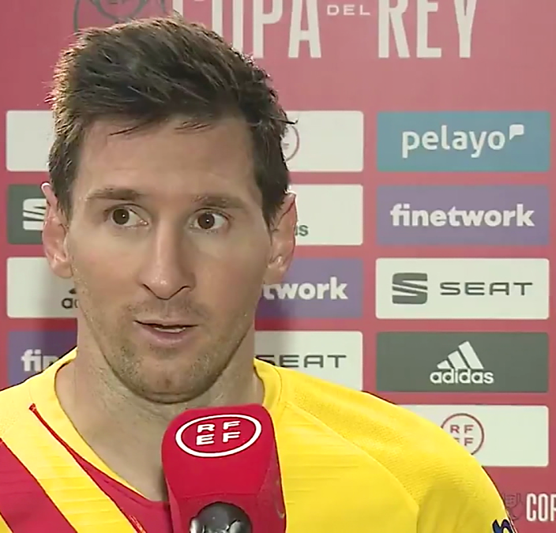
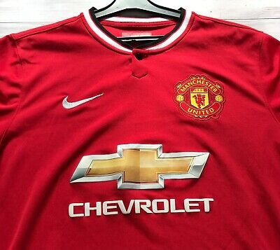

Extraction (Part II)

Slide 4

Brands
Are
EVERY- WHERE

Slide 5


Are They Getting
MILLIONS!
NOTICED?

Slide 7
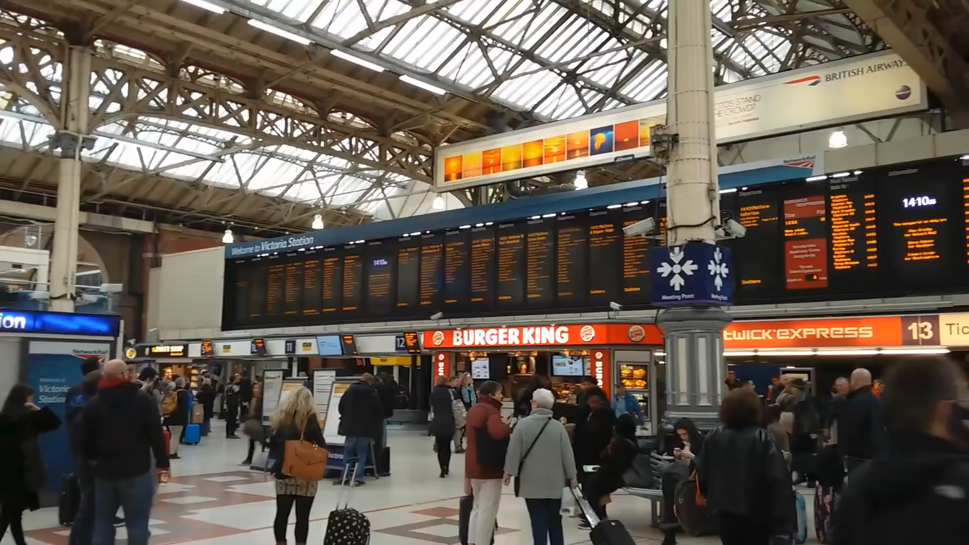

Slide 8
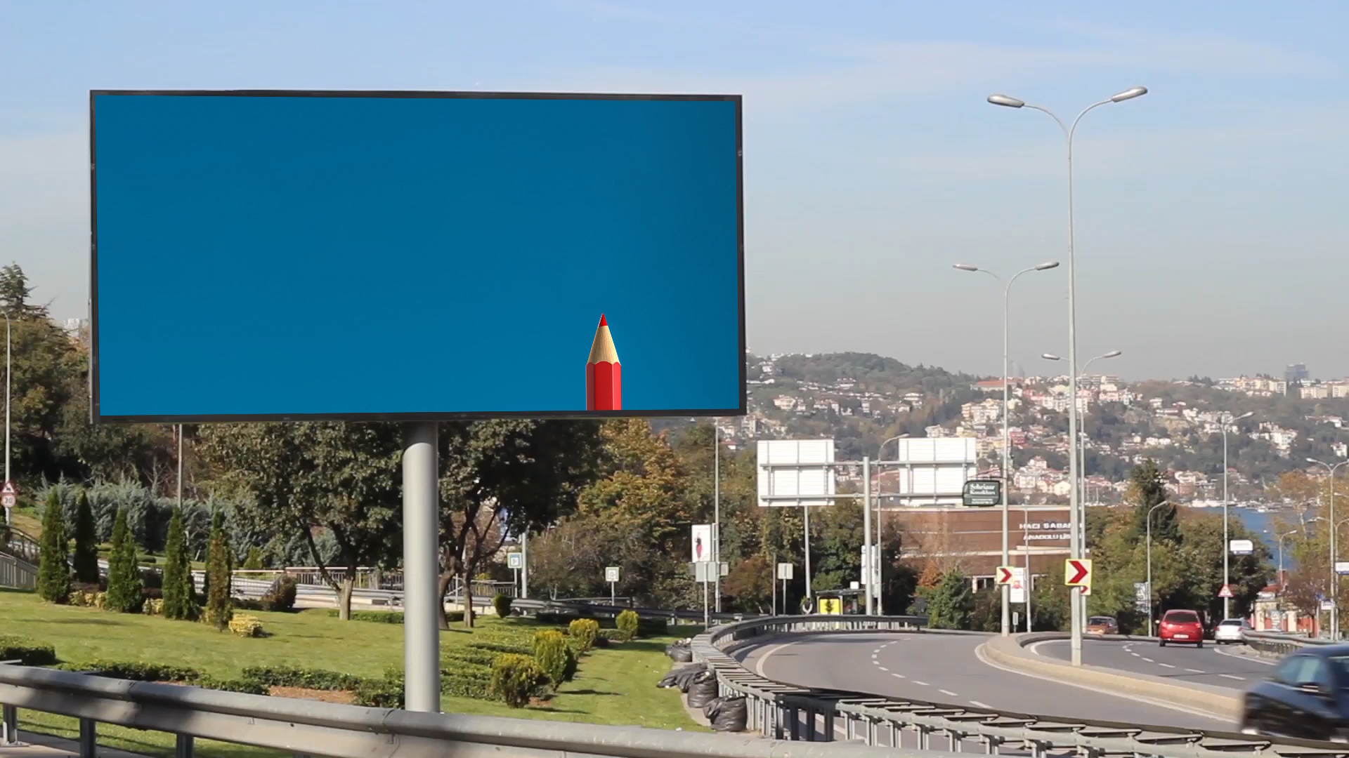

Slide 9
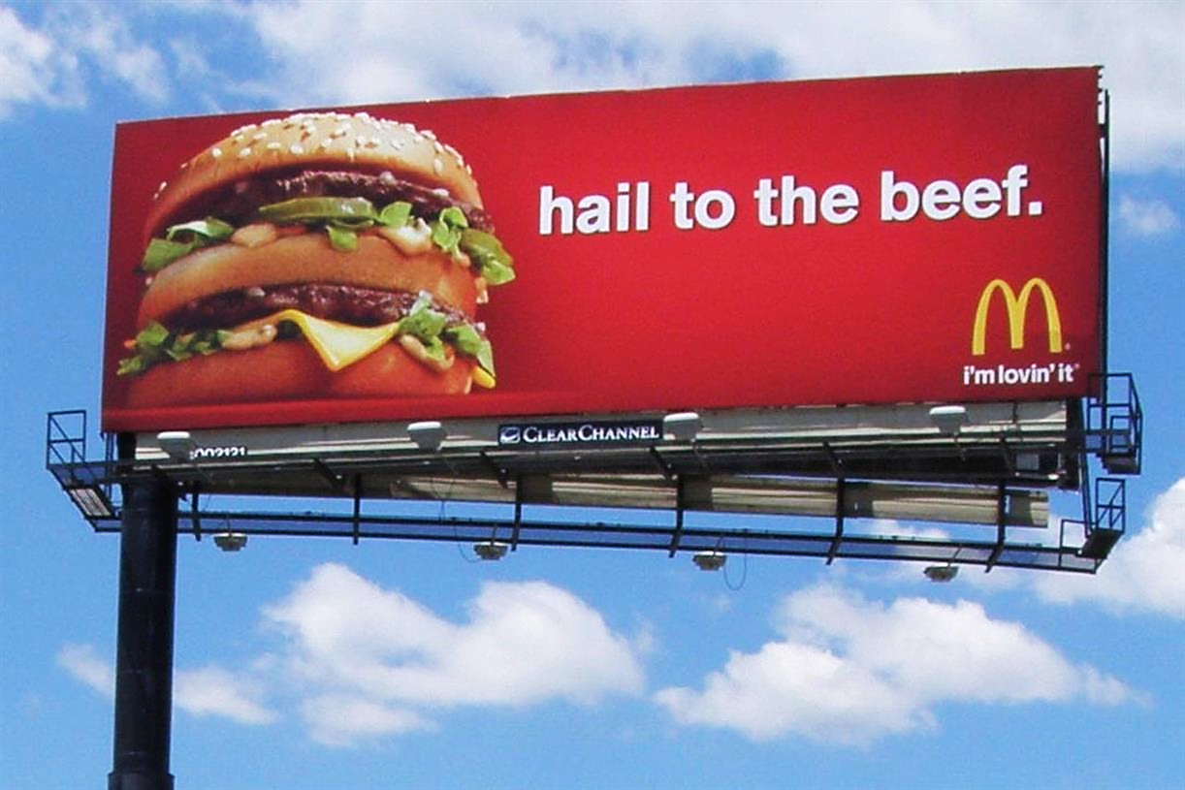
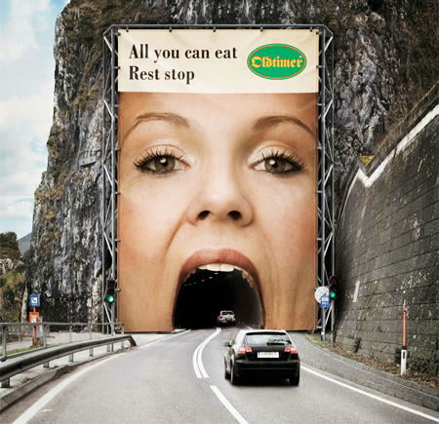
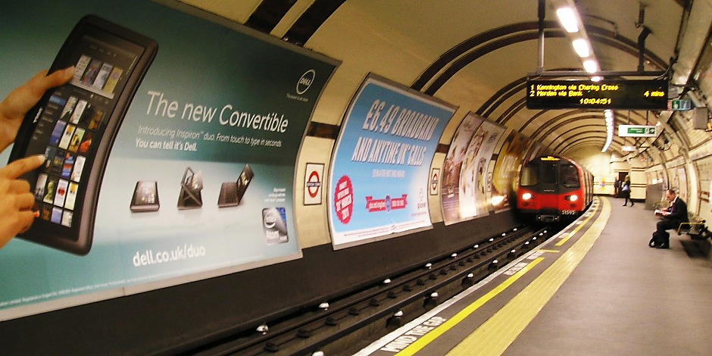

Slide 10







< >
B
Brand Miner

Slide 12
What brands appeared in this video?

Slide 13
What brands appeared in this video?
Rank brands by total screen time.

Slide 14

What brands appeared in this video?
Rank brands by total screen time.
Was “Brand X” mentioned in dialogue?

Slide 15

What brands appeared in this video?
Rank brands by total screen time.
Was “Brand X” mentioned in dialogue?
Create a heatmap grid for screen positions.

Slide 16

What brands appeared in this video?
Rank brands by total screen time.
Was “Brand X” mentioned in dialogue?
Create a heatmap grid for screen positions.
Spot brand exposure violations.

Slide 17


< MoviePy >

Slide 18



< MoviePy >
3 – 4 hr
Buy “BMWW” Cars please ☺
“Thesla” Cars!

Slide 19
< MoviePy >

Slide 20
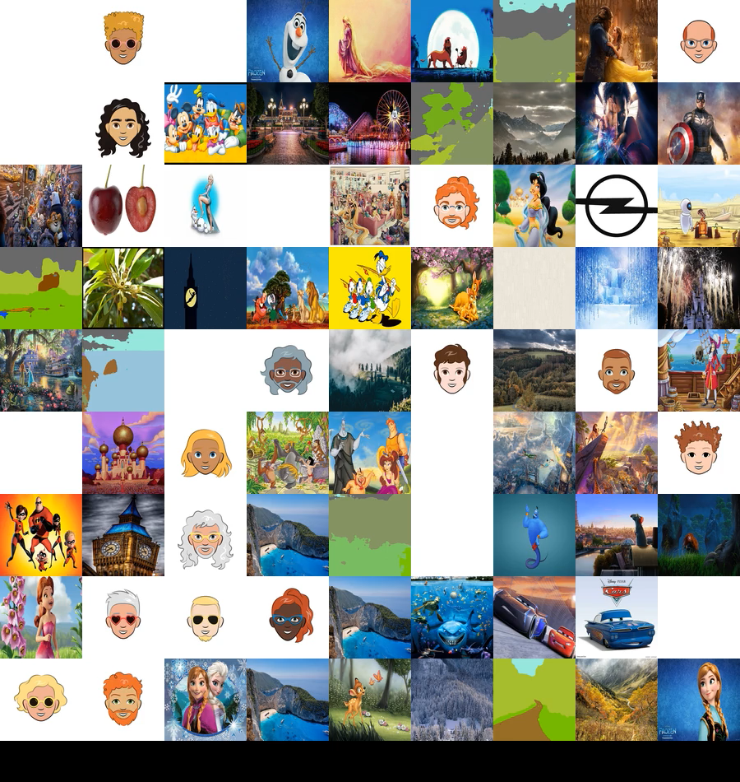

Slide 21


Slide 22

B

Slide 23
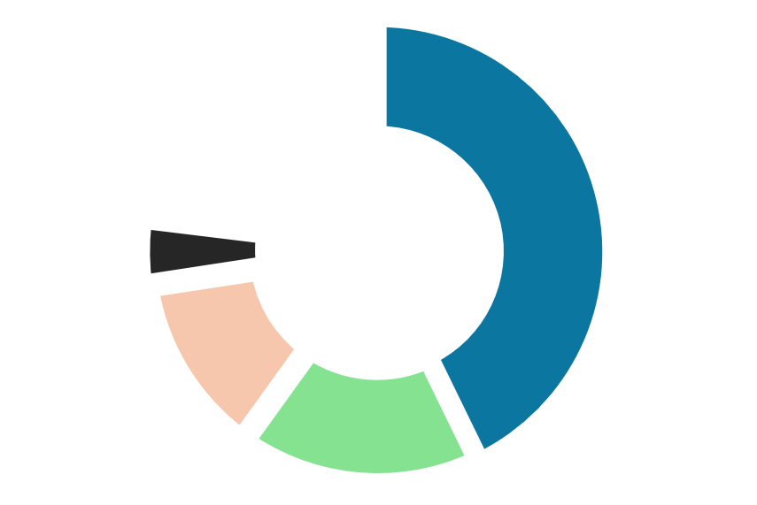
B
B

